Slide 1

The Unequal Burden of a Changing Climate: Extreme Weather Shocks and Infant Mortality

Slide 2
1. Introduction

Slide 3
The Question
How does exposure to weather shocks, either in-utero or during the first year of life, affect the likelihood of survival?

Slide 4
2. Literature Review (To do!)

Slide 5
3. Data

Slide 6
Data employed
DHS | Climate Data
 | ( ERA5)
60 countries | Worldwide coverage
Years 1998 to 2021 | Years 1950 to 2020
Annual | Monthly
Geo-located data is displaced up to 5 km (0-2 km urban, 0-5 km rural) | 0.5 x 0.5 gridded satellite data (~50km in equator, ~65km next to poles)
Mortality data for the first four quarters of life and three quarters of gestation of the mother | Temperature and Precipitation data

Slide 7
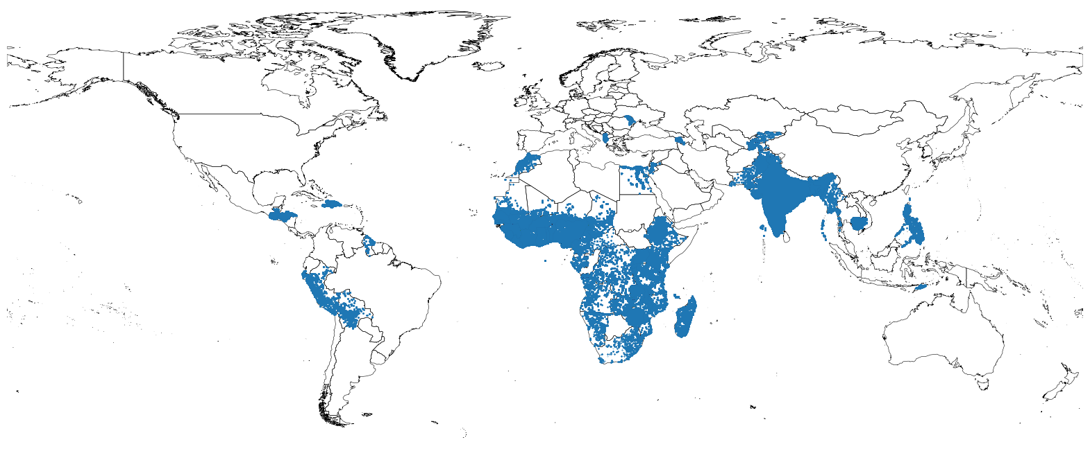
DHS Data

Slide 8
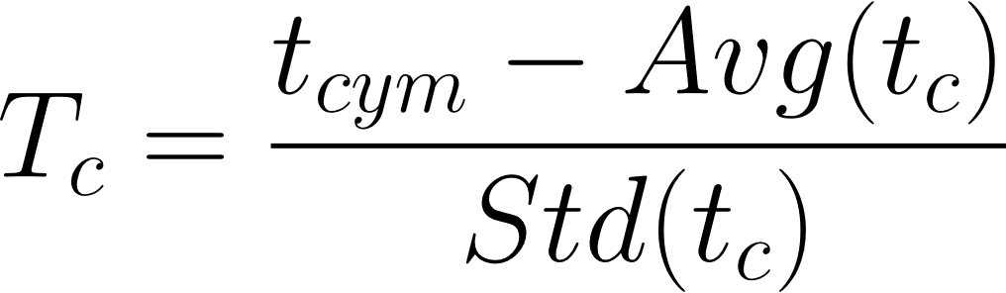
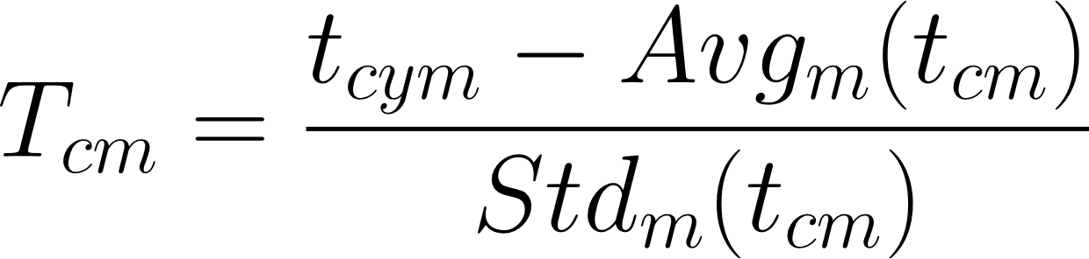
Climate Data: How should we measure Temperature shocks?
This is a discussion that we have been going for long, but now in the light of the new results its more relevant than previously was.
Using the linear dummy model with SPI, we've found consistent results for standardized temperature and monthly temperature anomalies:
Given the fact that we include monthly fixed effects in the regressions, it's likely that both estimates are similar (which in fact they are).
Standardized temperature
Monthly temperature anomalies

Slide 9
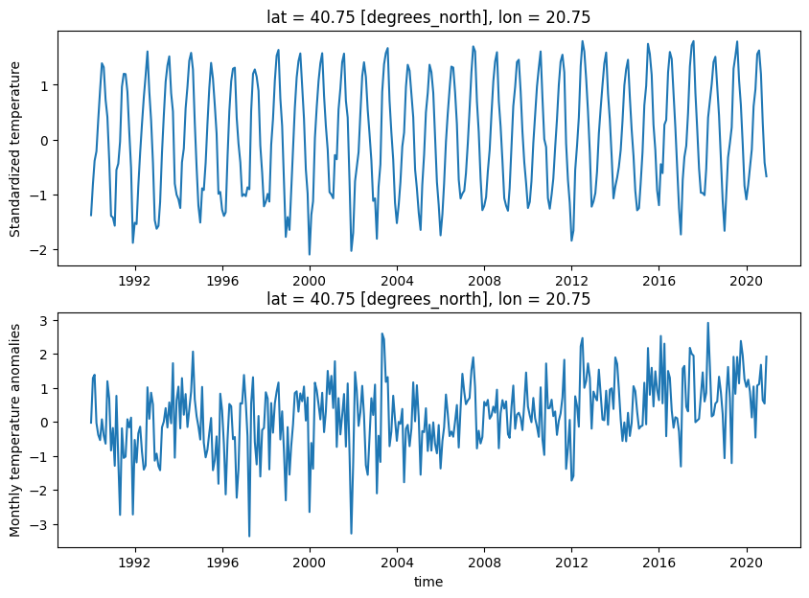
Climate Data: How should we measure Temperature shocks?
This is a discussion that we have been going for long, but now in the light of the new results its more relevant than previously was.
Using the linear dummy model with SPI, we've found consistent results for standardized temperature and monthly temperature anomalies...

Slide 10
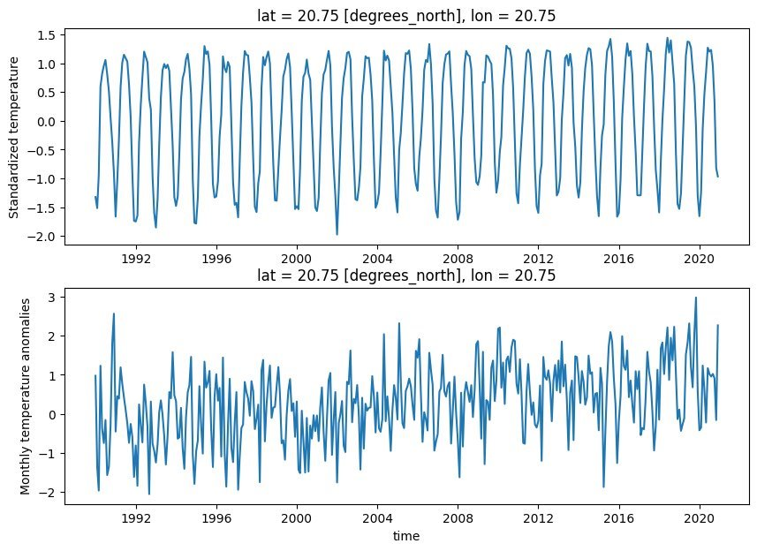
Climate Data: How should we measure Temperature shocks?
This is a discussion that we have been going for long, but now in the light of the new results its more relevant than previously was.
Using the linear dummy model with SPI, we've found consistent results for standardized temperature and monthly temperature anomalies...

Slide 11
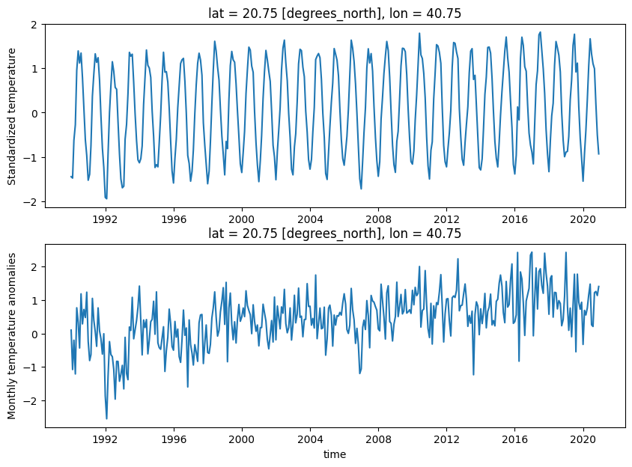
Climate Data: How should we measure Temperature shocks?
This is a discussion that we have been going for long, but now in the light of the new results its more relevant than previously was.
Using the linear dummy model with SPI, we've found consistent results for standardized temperature and monthly temperature anomalies...

Slide 12
Climate Data: How should we measure Temperature shocks?
How likely are these monthly temperature anomalies?

Slide 13
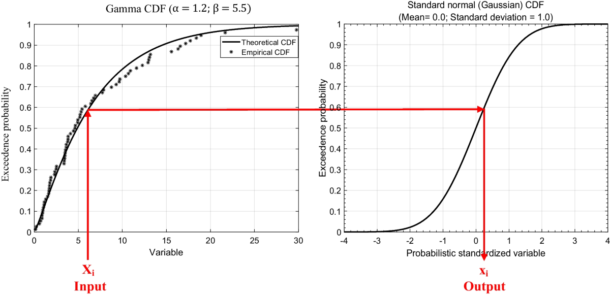
Climate Data: How should we measure Precipitation shocks?
Precipitation data is highly skewed, so a simple standardization might not be a good solution.
The Standardized precipitation Index comes in handy as it is an indicator easy to compute, comparable between countries, and with a similar interpretation than standardized temperature anomalies.​
It is computed by fitting the observed distribution of each cell to a Gamma distribution, and then matching it to a normal distribution.

Slide 14
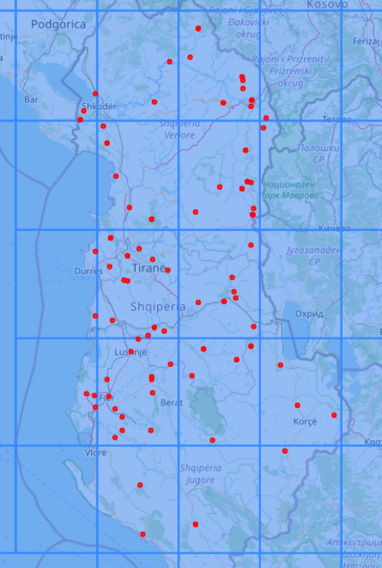
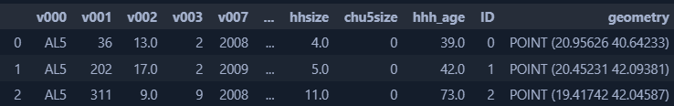
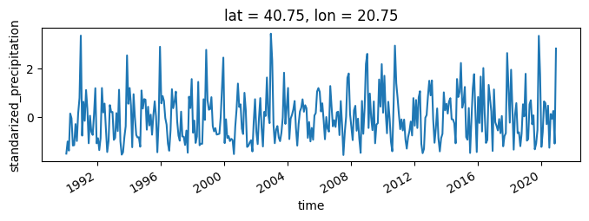
Merging Climate data with DHS data
We first assign each DHS observation to a single cell of the grid with the climate data
DHS data
Climate data

Slide 15
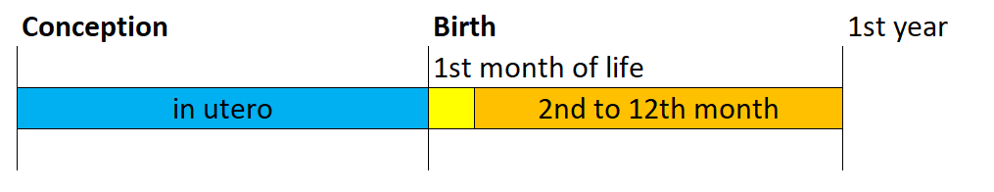
Creating exposure variables
Weather exposure is divided into 7 quarters: 3 in utero quarters, 4 quarters after birth
We compute the average 1-month Standardized Precipitation Index and Standardized Temperature Anomaly for the corresponding quarter.

Slide 16
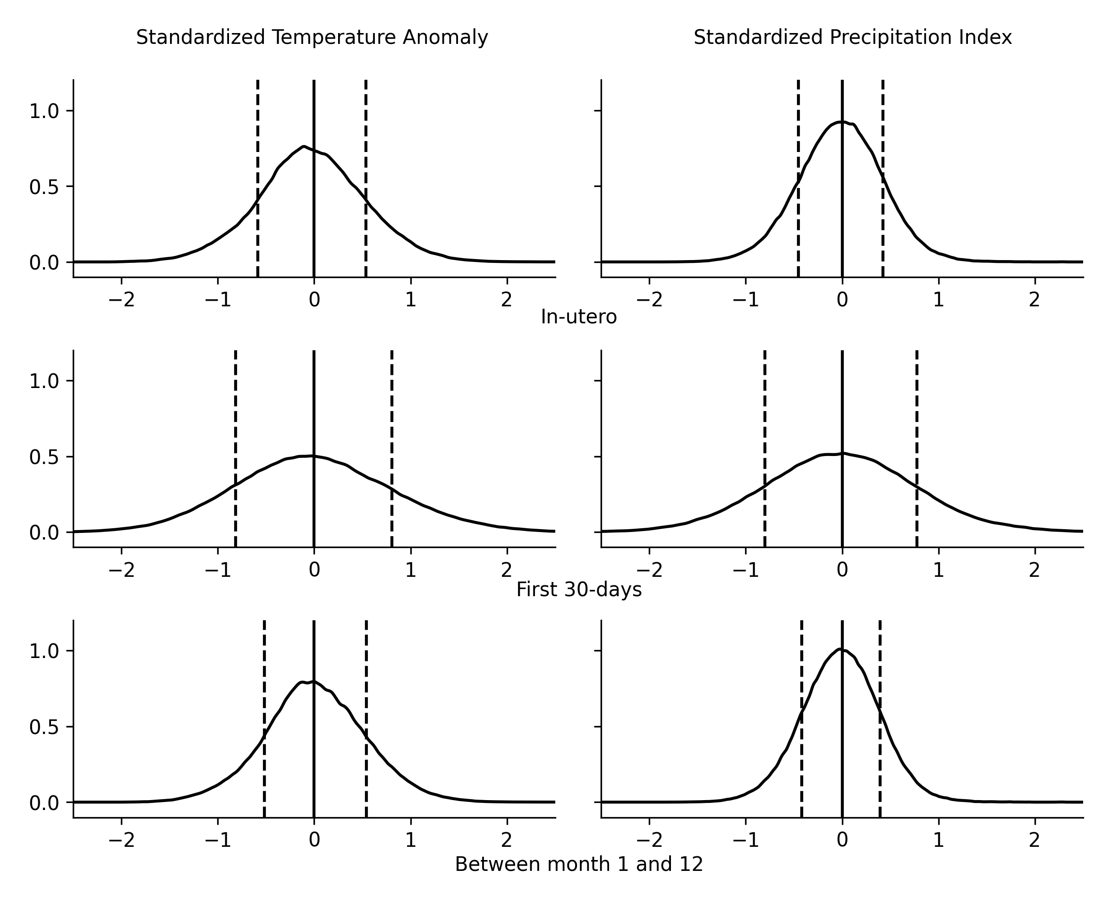
Resulting shock distribution
This method of aggregating by taking the average of each period means that each variable will have a different variance.
The higher the aggregation period, the lower the variance of the distribution.

Slide 17
4. Empirical Identification Strategy

Slide 18
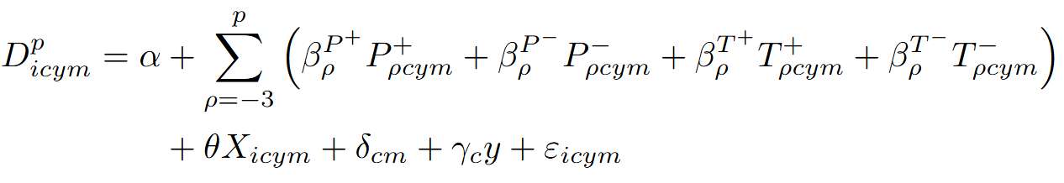
Empirical Strategy: linear model
Estimated for each period p conditional on survival to p-1, where:
D is a dummy variable equal to 1 if the child i, living in cell c, born in year y, and in month m, died. This dummy is multiplied by 1,000 to reflect mortality rates per 1,000 children instead of probability in the estimates.
P and T are the precipitation (SPI) and temperature indicates of the cell at the period rho (each quarter in utero and until the first age).
X is a set of controls including child gender, multiple birth indicator, birth order, age of mother (cubic), years of maternal education (cubic), rural indicator and wealth index quintile.
Delta represents fixed effects for cell-month (for stationarity) and gamma represents cell fixed effects interacted with time to control for a cell-specific linear trends.

Slide 19
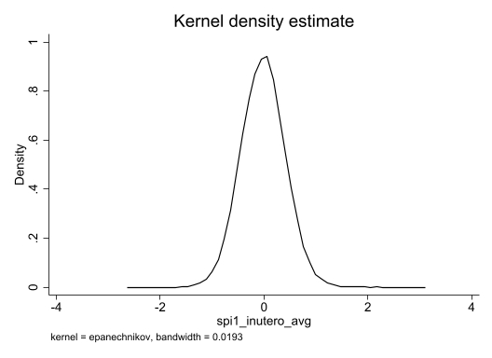
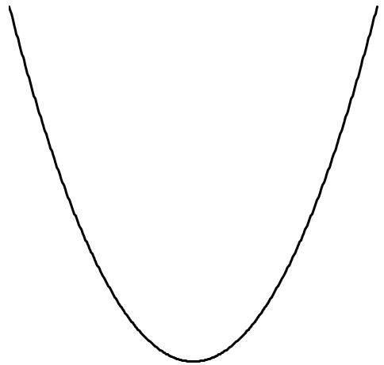
Empirical Strategy: linear model
What we expect is that extreme shocks (in any direction) will lead to an increase in child mortality: the further the indicator is from zero, the higher the increase in mortality.
Child Mortality

Slide 20
Empirical Strategy: linear model
What we expect is that extreme shocks (in any direction) will lead to an increase in child mortality: the further the indicator is from zero, the higher the increase in mortality.
A negative coefficient means
↑ Deaths
A positive coefficient means
↑ Deaths
Child Mortality

Slide 21
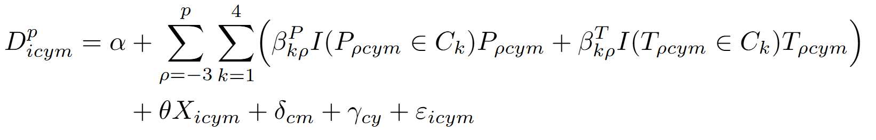
Alternative model: Linear Spline Regression
Instead of dividing precipitation and temperature over positive and negative values, we split the ditribution into four bins each: below –1 standard deviations of the DHS distribution, between –1 sd and the mean, between the mean and 1 sd, and above 1 standard deviation.
Therefore, we will have a particular slope for severe- and moderate-, positive- and negative- precipitation shocks, as weel as the same set for temperature.

Slide 22
Alternative model: Linear Spline Regression
Child Mortality

Slide 23
Alternative model 2: Quadratic specification
This model assumes symmetry in the impact of the shocks: both positive and negative precipitation/temperature shocks will have the same estimated impact.
Child Mortality

Slide 24
Cell identifiers for the spatial fixed effect
Number of observations in each cluster of cell#month, with different cell sizes
We constructed IDs for each cell.
Since some cells had only a few households, we tested if combining these cells and creating larger groups mantained the results.
 | Ungrouped | Groups of 4 cells | Groups of 16 cells | Groups of 64 cells
Grid size (side) | 0.5° | 1° | 2° | 4°
Size in km | 50x50km | 100x100km | 200x200km | 400x400km
Number of children
Less than 5 | 15.3% | 9.1% | 5.1% | 2.6%
Less than 10 | 30.5% | 18.1% | 9.9% | 6.6%
Less than 20 | 47.6% | 30.0% | 16.4% | 10.7%
Less than 30 | 57.8% | 37.8% | 20.5% | 13.4%
Less than 40 | 65.0% | 43.5% | 24.0% | 15.7%
Less than 50 | 70.5% | 48.2% | 27.1% | 17.1%
Less than 100 | 84.8% | 62.7% | 39.8% | 23.8%

Slide 25
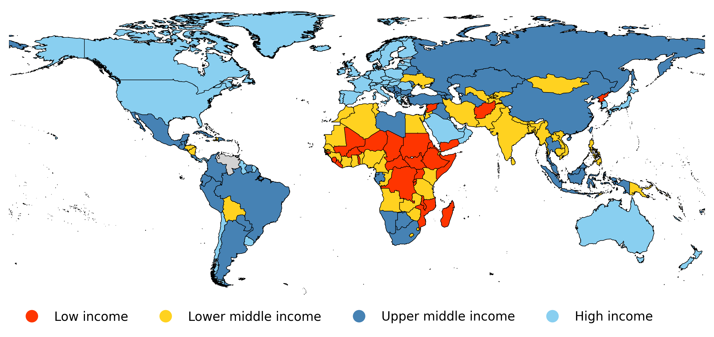
Heterogeneity: Income groups
Instead of using GPD as is, which would require to interact all the variables with the contious GPD, we used the WB income group classification to make it easier to interpret:

Slide 26
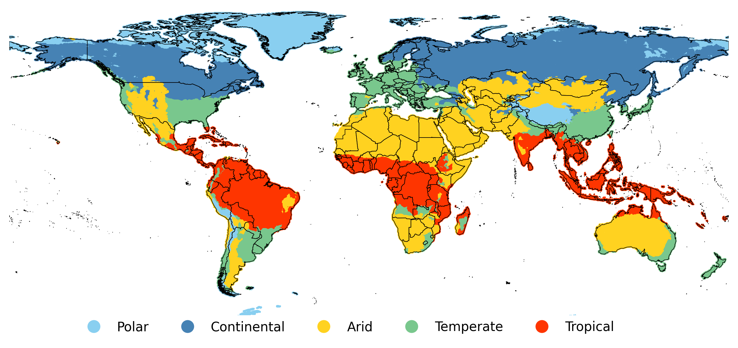
Heterogeneity: Climatic bands
To define climatic bands (i.e. groups based on patterns of seasonal precipitation and temperature) we used the Köppen-Geiger climate classification published by Kottek et al. (2006), Rubel and Kottek (2010) and Rubel et al. (2017).

Slide 27
5. Results

Slide 28
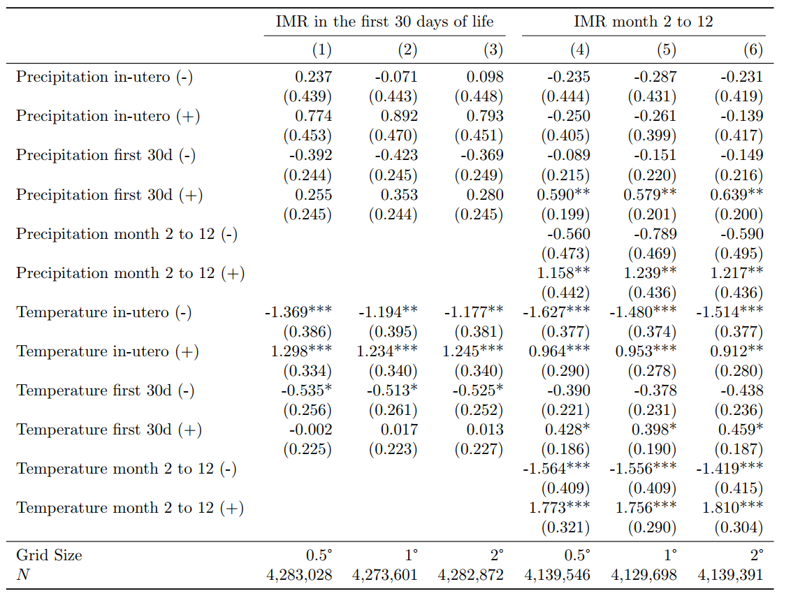
Main Results

Slide 29
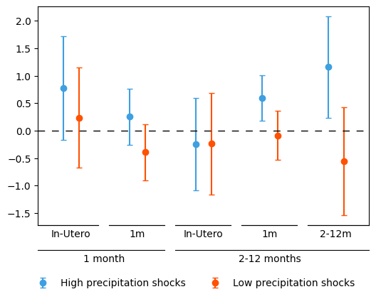
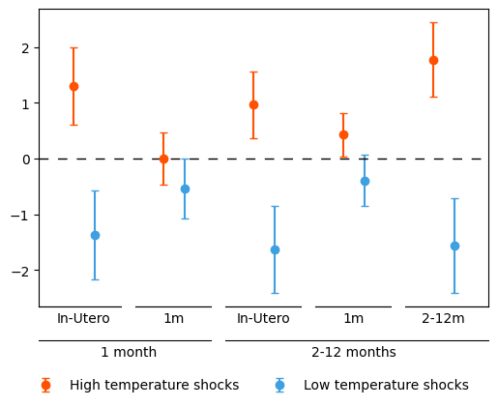
Main Results: easier visualization

Slide 30
Main Results: easier visualization

Slide 31
Main Results
Precipitation
Temperature
IMR
When the shock
happend

Slide 32
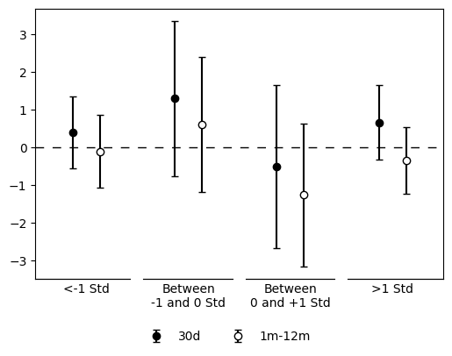
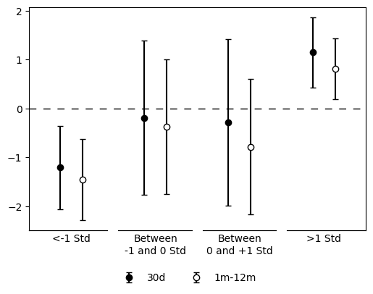
Spline Model: in-utero
Precipitation
Temperature

Slide 33
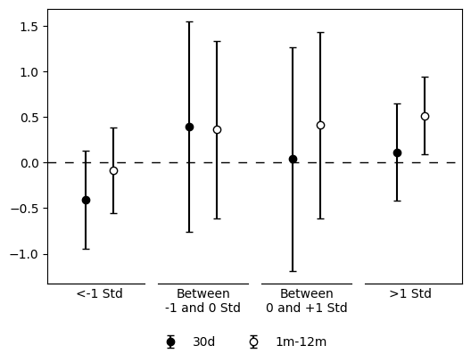
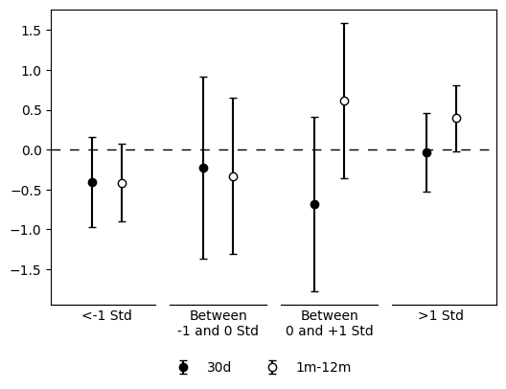
Spline Model: First 30 days of life
Precipitation
Temperature

Slide 34
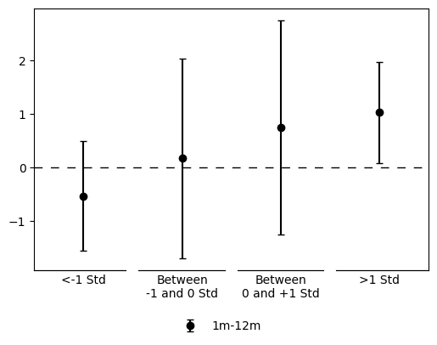
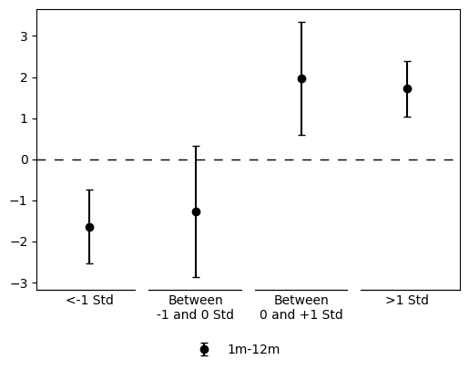
Spline Model: between 2nd to 12th month
Precipitation
Temperature

Slide 35
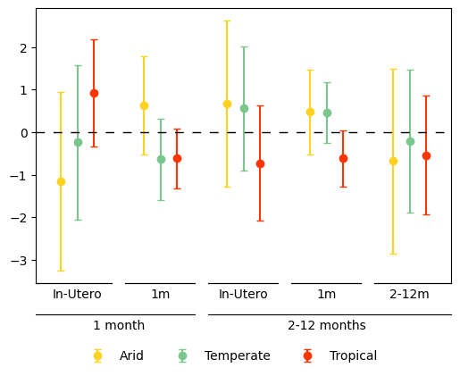
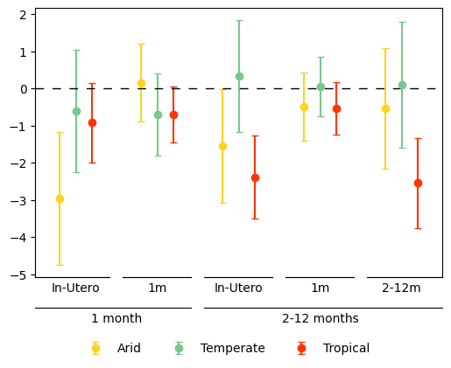
Main Results by Climate Bands: Negative Shocks
Precipitation
Temperature
IMR
When the shock
happend

Slide 36
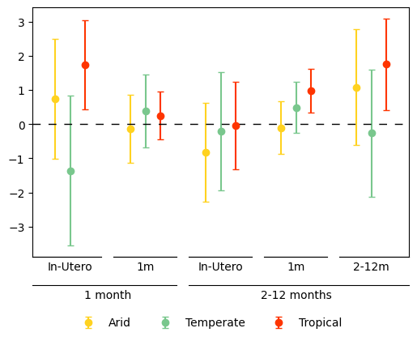
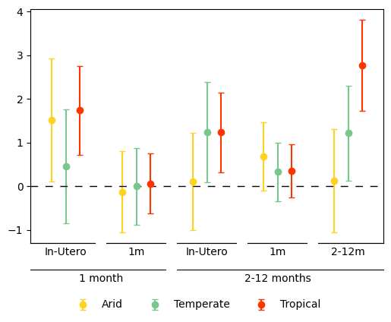
Main Results by Climate Bands: Positive Shocks
Precipitation
Temperature
IMR
When the shock
happend

Slide 37
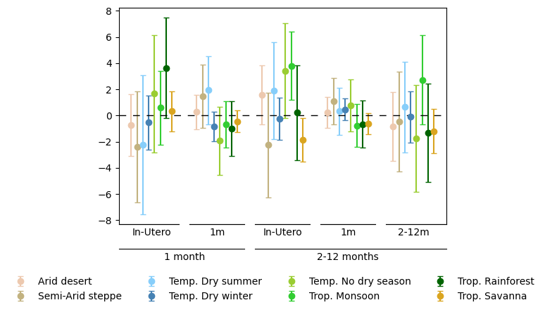
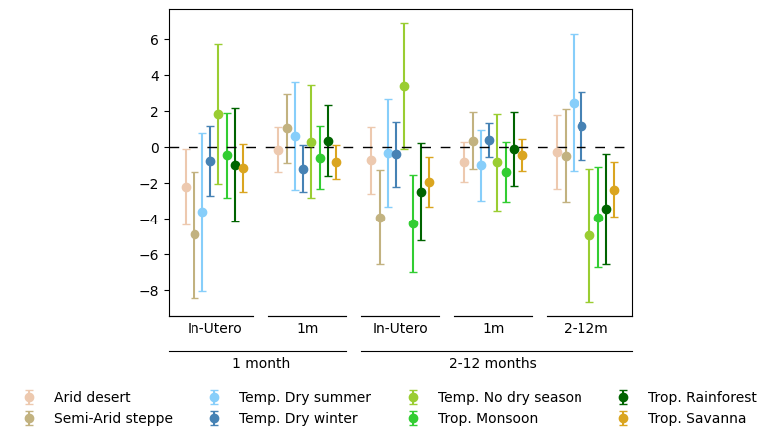
Main Results by Climate Bands: Negative shocks
Precipitation
Temperature

Slide 38
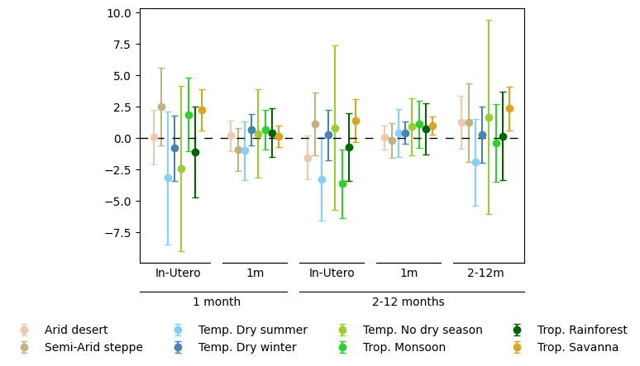
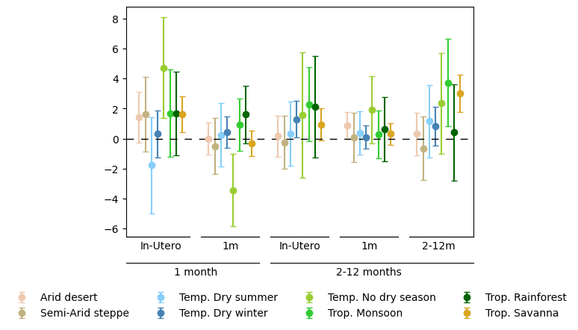
Main Results by Climate Bands: Positive shocks
Precipitation
Temperature

Slide 39
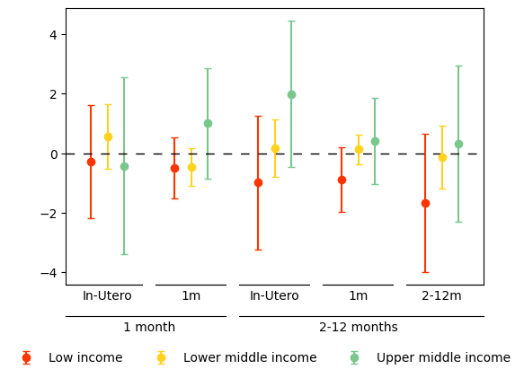
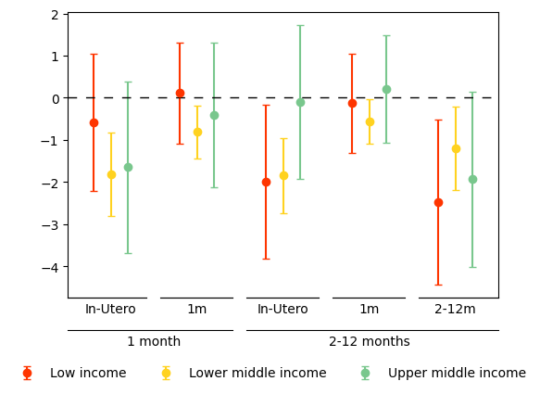
Main Results by Income Group: Negative Shocks
Precipitation
Temperature

Slide 40
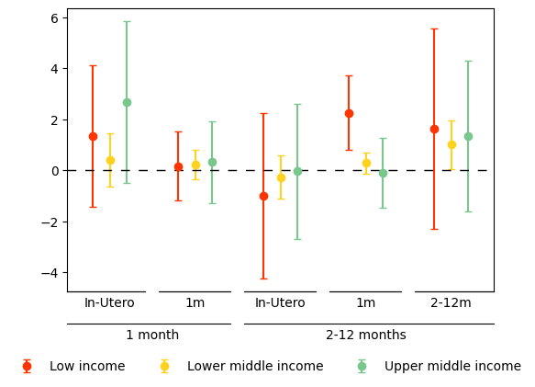
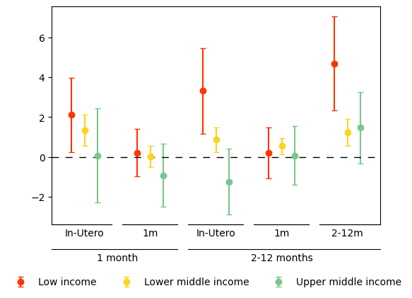
Main Results by Income Group: Positive Shocks
Precipitation
Temperature

Slide 41
6. Mechanisms?

Slide 42
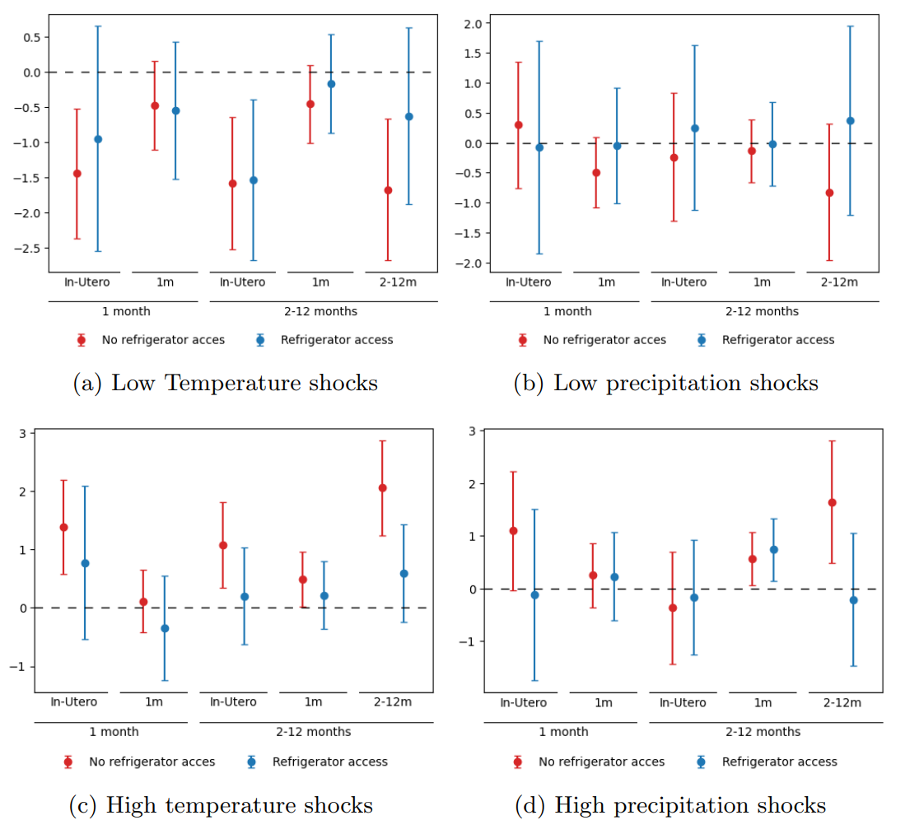
Linear Results by Access to Food Refrigeration

Slide 43
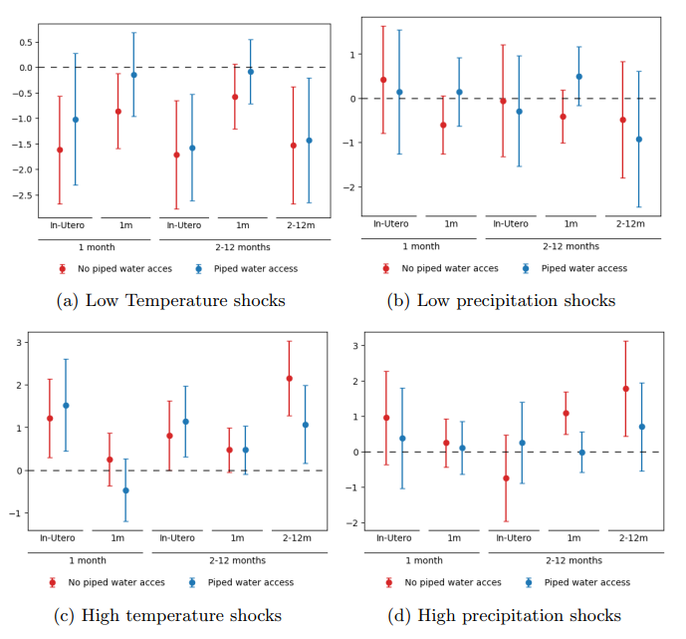
Linear Results by Access to Piped Water

Slide 44
7. Robustness checks

Slide 45
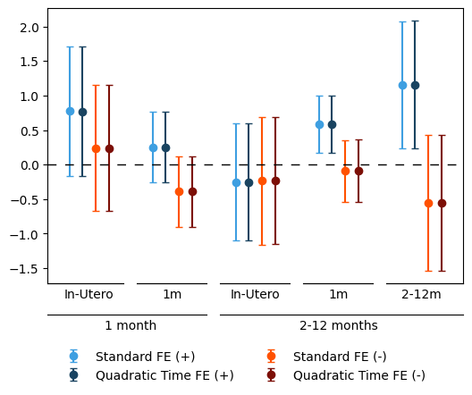
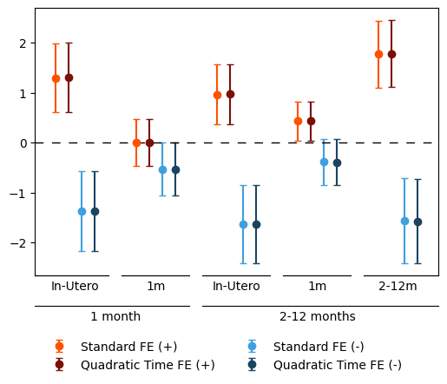
Controlling for quadratic linear trend on each cell
Precipitation
Temperature

Slide 46
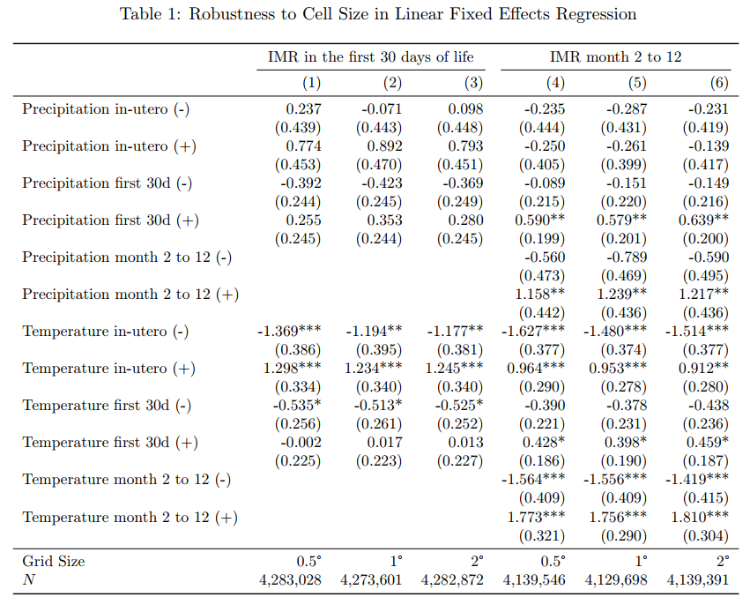
Linear model and cell size

Slide 47
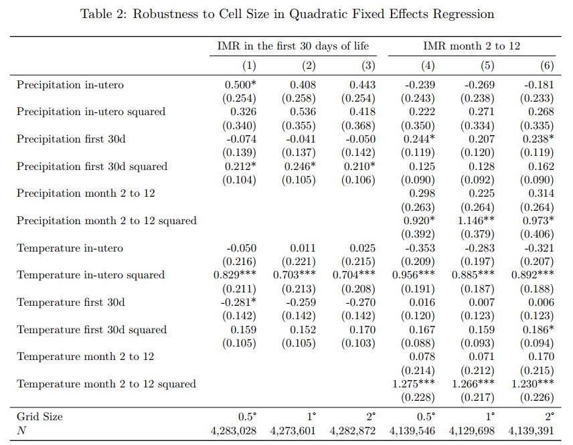
Quadratic model

Slide 48
Absolute deviations model

Slide 49
Thank you!

